Slide 1



Chapter 1 The Internet and World Wide Web
Web Programming Step by Step
Except where otherwise noted, the contents of this presentation are Copyright 2009 Marty Stepp and Jessica Miller.

Slide 2


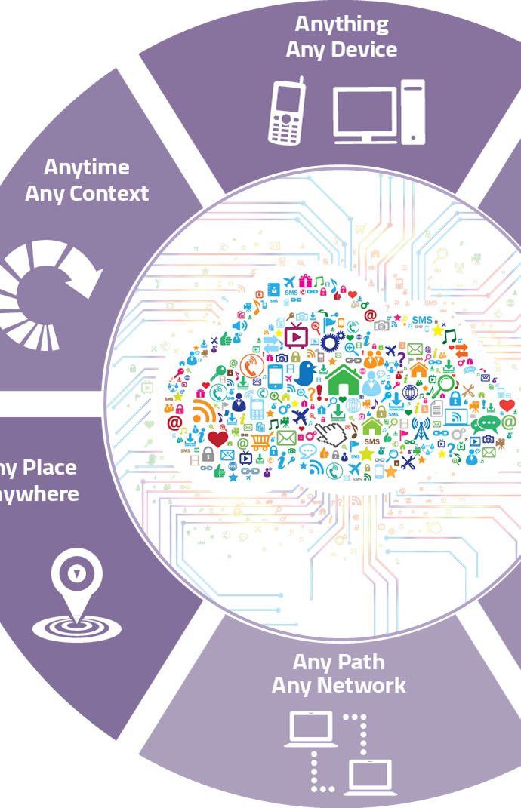

1.1 The Internet
1.1: The Internet
1.2: The World Wide Web

Slide 3
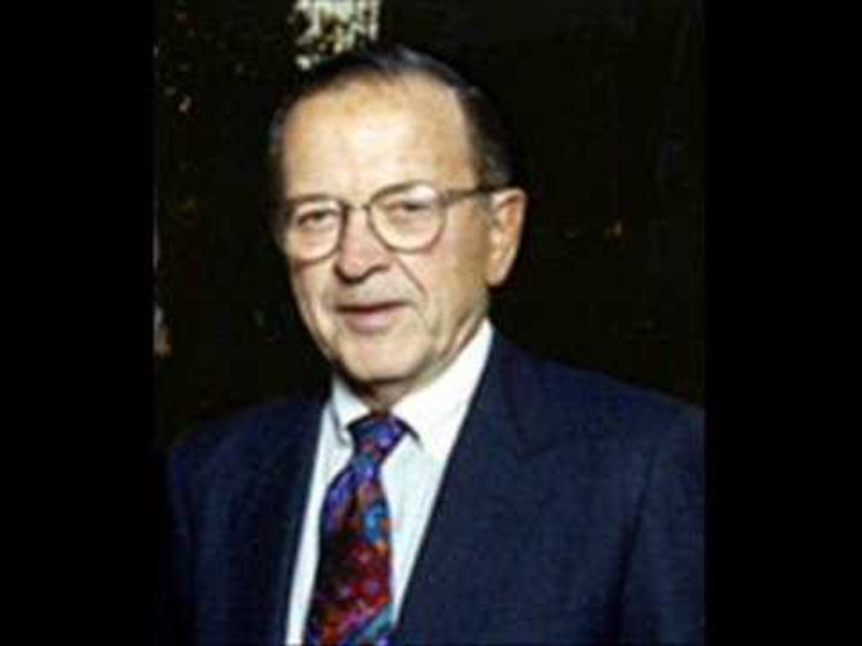
What is the Internet?
In an infamous comment, United States Senator Ted Stevens gave this explanation.
June 28th, 2006 Committee hearing
Explanation can be found here.

Slide 4
What is the Internet?
How many internets are there, anyway?
Is Google one of these internets?

Slide 5
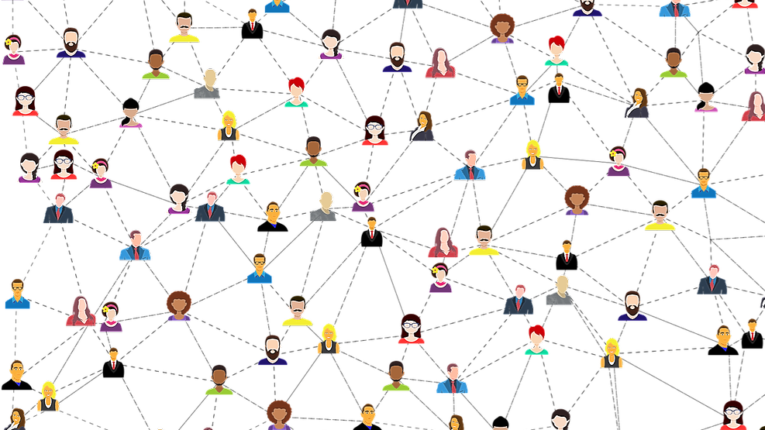
The Internet
Wikipedia entry on “Internet”
A connection of computer networks using the Internet Protocol (IP).
What’s the difference between the Internet and the World Wide Web?

Slide 6
Brief History of the Internet
began as a US Department of Defense network called ARPANET (Funded 1966, Created 1969, Closed 1990)
initial services: electronic mail, file transfer
opened to commercial interests in late 80s
WWW created in 1989-91 by Tim Berners-Lee at CERN
popular web browsers released: Netscape 1994, IE 1995
Amazon.com opens in 1995; Google January 1996
Hamster Dance web page created in 1999
Notes:
ARPANET – connected 3 computers in Utah and California.
WWW created on a NeXT Computer for distributed documentation system for scientists.
First browser was Mosaic at U. of Illinois at NCSA by marc Andreessen

Slide 7
Key Aspects of the Internet
Subnetworks can stand and operate on their own
Computers can dynamically join and leave
Built on open standards; anyone can create a new Internet-ready device
Lack of centralized control (mostly)
Everyone can use it with simple, commonly available software
Notes:
Computer just need TCP/IP software to connect.
Protocols or rules developed with help of Internet Engineering Task Force, Internet Research Task Force, and Internet Architecture Board
Censorship and control of truth as a narrative is an issue the past 10 years.

Slide 8



People and Organizations
Internet Engineering Task Force (IETF): controls internet protocol standards
Internet Corporation for Assigned Names and Numbers (ICANN): decides top-level domain names
World Wide Web Consortium (W3C): web standards

Slide 9
Layered Architecture
The internet uses a layered hardware/software architecture (also called the "OSI model"):
physical layer : ethernet, coaxial cables, fiber-optic lines, modems
data link layer : basic hardware protocols (Ethernet, WiFi, DSL PPP)
network / internet layer : basic software protocol (IP)
transport layer : adds reliability to network layer (TCP, UDP)
application layer : implements specific communication for each kind of program (HTTP, POP3/IMAP, SSH, FTP)

Slide 10
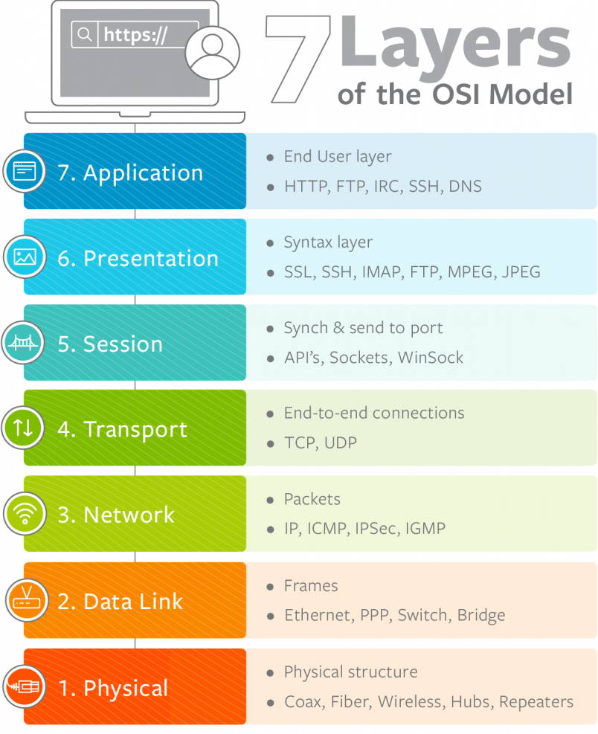
Layered Architecture
z

Slide 11
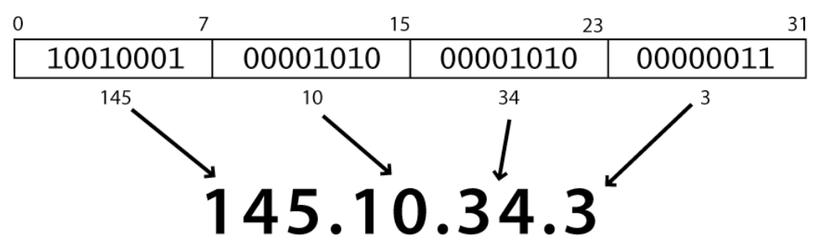
Internet Protocol
a simple protocol for attempting to send data between two computers
each device has a 32-bit IP address written as four 8-bit numbers (0-255)

Slide 12
Internet Protocol
find out your internet IP address: whatismyip.com
find out your local IP address:
in a terminal, type: ipconfig (Windows) or ifconfig (Mac/Linux)

Slide 13
Transmission Control Protocol
adds multiplexing, guaranteed message delivery on top of IP
multiplexing: multiple programs using the same IP address
port: a number given to each program or service
port 80: web browser (port 443 for secure browsing)
more common ports
some programs (games, streaming media programs) use simpler UDP protocol instead of TCP
Notes:
Why UDP for gaming and streaming?

Slide 14
1.2 The World Wide Web
1.1: The Internet
1.2: The World Wide Web

Slide 15


Web servers and browsers
Web server: software that listens for web page requests
Apache
Microsoft Internet Information Server
nginx
Notes:
Apache 27%
MIIS 8%
Nginx 34%
Google 4%

Slide 16
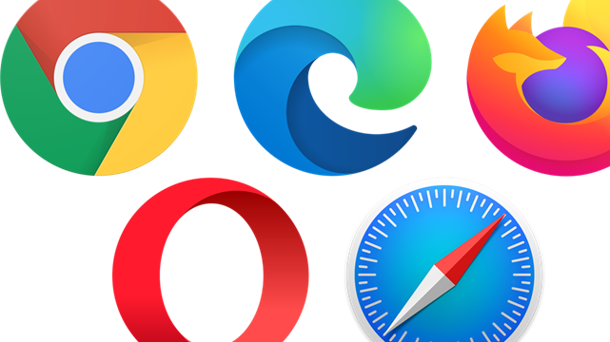
Web browsers
Web browser: fetches / displays documents from web servers.
Mozilla Firefox
Microsoft Internet Explorer (and Edge)
Apple Safari
Google Chrome
Opera (from Norway)

Slide 17
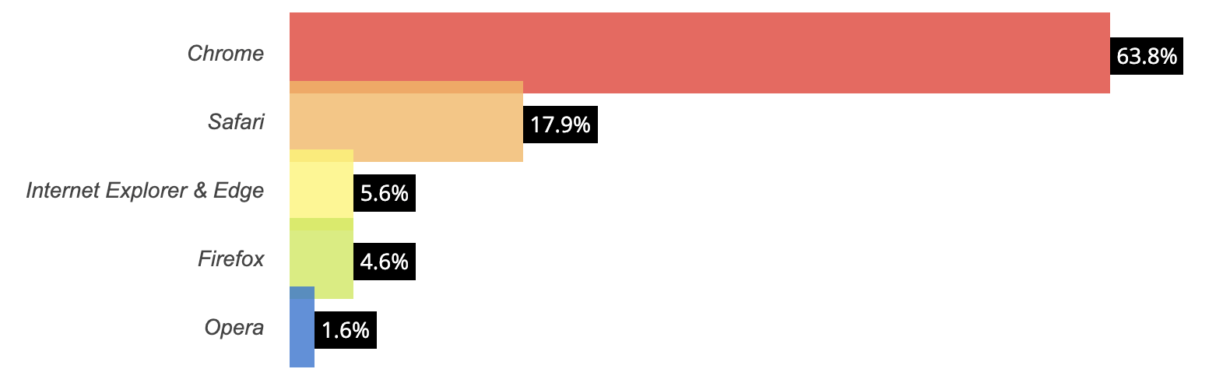
Web browser market share 2020

Slide 18
Domain Name System (DNS)
a set of servers that map written names to IP addresses Example: www.blc.edu → 198.160.171.4
many systems maintain a local cache called a hosts file
Windows: C:\Windows\system32\drivers\etc\hosts
Mac: /private/etc/hosts
Linux: /etc/hosts

Slide 19
Uniform Resource Locator (URL)
an identifier for the location of a document on a web site
a basic URL: http://www.aw-bc.com/info/regesstepp/index.html ~~~~ ~~~~~~~~~~~~~ ~~~~~~~~~~~~~~~~~~~~~~~~~~ protocol host path
upon entering this URL into the browser, it would:
ask the DNS server for the IP address of www.aw-bc.com
connect to that IP address at port 80
ask the server to GET /info/regesstepp/index.html
display the resulting page on the screen

Slide 20
More advanced URLs
anchor: jumps to a given section of a web page http://www.textpad.com/download/index.html#downloads
fetches index.html then jumps down to part of the page labeled downloads
port: for web servers on ports other than the default 80 http://www.blc.edu:8080/secret/money.txt
query string: a set of parameters passed to a web program http://www.google.com/search?q=Bethany+Lutheran&start=10
parameter q is set to ”Bethany+Lutheran"
parameter start is set to 10

Slide 21
Hypertext Transport Protocol
the set of commands understood by a web server and sent from a browser
some HTTP commands (your browser sends these internally):
GET filename : download
POST filename : send a web form response
PUT filename : upload

Slide 22
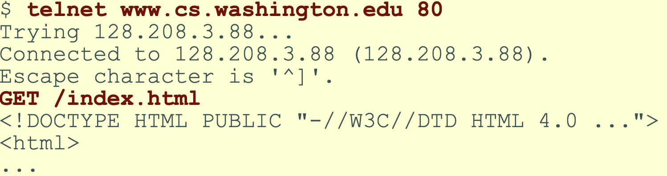
Hypertext Transport Protocol
simulating a browser with a terminal window:

Slide 23
HTTP error codes
when something goes wrong, the web server returns a special "error code" number to the browser, possibly followed by an HTML document
common error codes:
Number | Meaning
200 | OK
301-303 | page has moved (permanently or temporarily)
403 | you are forbidden to access this page
404 | page not found
500 | internal server error
complete list

Slide 24
Internet media (“MIME”)
sometimes when including resources in a page (style sheet, icon, multimedia object), we specify their type of data
List of MIME types: by type, by extension
MIME type | file extension
text/html | .html
text/plain | .txt
image/gif | .gif
image/jpeg | .jpg
video/quicktime | .mov
application/octet-stream | .exe

Slide 25
Web languages / technologies
Hypertext Markup Language (HTML): used for writing web pages
Cascading Style Sheets (CSS): stylistic info for web pages
PHP Hypertext Processor (PHP): dynamically create pages on a web server
JavaScript: interactive and programmable web pages
Asynchronous JavaScript and XML (Ajax): accessing data for web applications
eXtensible Markup Language (XML): metalanguage for organizing data
Structured Query Language (SQL): interaction with databases

